Slide 1
AI Based Leaf Disease Identification and Classification System Using Deep Learning
GUIDED BY,
Mr. V. Solai Raja M.E.,
Team Members,
V Arun
M Ganesh Pandiyan
V Kaleeswaran
P Ramkumar

Slide 2
OBJECTIVE
To develop tomato leaf disease system using python software with DCNN algorithm.

Slide 3
ABSTRACT
Tomato cultivation is a vital component of global agriculture, contributing significantly to both food security and economic development.
However, the occurrence of diseases in tomato plants poses a significant threat to crop yield and quality.
Early detection and diagnosis of these diseases are crucial for effective disease management.
In recent years, Artificial Intelligence (AI) techniques, particularly Convolutional Neural Networks (CNNs) such as DCNN, have shown promise in automating the detection and classification of plant diseases.
This research explores the application of DCNN in the context of tomato leaf disease detection. The study involves the collection of a diverse dataset of tomato leaf images representing various diseases and healthy states.
The dataset is pre-processed to enhance the model's ability to generalize across different conditions. DCNN, a type of deep neural network architecture known for its dense connectivity and feature reuse, is employed for the classification task.

Slide 4
ABSTRACT
The model is trained on the prepared dataset, utilizing transfer learning techniques to leverage knowledge gained from pre-trained models on large image datasets.
The training process involves optimizing model parameters through back propagation, enabling the network to learn discriminative features for distinguishing between different tomato leaf conditions.
The effectiveness of the model is assessed through rigorous testing on an independent dataset, and performance metrics such as accuracy, precision, recall, and F1-score are computed.
The results demonstrate the potential of DCNN in accurately identifying and classifying tomato leaf diseases.
The AI model exhibits robust performance even in the presence of variations in lighting conditions, leaf orientations, and disease severity. Moreover, the ability to detect diseases at an early stage holds promise for timely intervention and disease management strategies.

Slide 5
INTRODUCTION
Plant diseases have become more prevalent in recent years due to globalization, trade, and climate change .
These issues have reached pandemic proportions in several nations, which increased the likelihood of crop damage and, in turn, created a threat to people’s access to adequate food and nutrition .
Specialists should ensure to safeguard agricultural plants.
Parasitic organisms such as bacteria, fungi, viruses, roundworms (nematodes), and other plants can cause illnesses.
Environmental conditions such as winter frosts or summer dryness and lack or excess of nutrients in the soil can be the potential causes of plant diseases .

Slide 6
Literature Survey-1
Title | Author | Year | Description
Role of Machine Learning and Cloud-Driven Platform in IoT-Based Smart Farming | Astik Kumar Pradhan, Satyajit Swain and Jitendra Kumar Rout | 2022 | Crops, their production, and quality are all vital to a farmer’s livelihood. Agriculture is our country’s most basic and important occupation, as it balances food demand while also supplying vital raw materials for a variety of industries. The amalgamation of machine learning (ML) and Internet of Things (IoT)-based advanced smart farming tools are turning the face of agricultural production day after day not only by improving it but also by rendering it cost-effective and reducing waste.

Slide 7
Literature Survey-2
Title | Author | Year | Description
Fruits and vegetables quality evaluation using computer vision: A review | Anuja Bhargava, Atul Bansal | 2021 | The crucial sensory characteristic of fruits and vegetables is appearance that impacts their market value, the consumer’s preference and choice. Although, the sorting and grading can be done by human but it is inconsistent, time consuming, variable, subjective, onerous, expensive and easily influenced by surrounding. Hence, an astute fruit grading system is needed. In recent years, various algorithms for sorting and grading are done by various researchers using computer vision.

Slide 8
Literature Survey-3
Title | Author | Year | Description
A survey on using deep learning techniques for plant disease diagnosis and recommendations for development of appropriate tools | Aanis Ahmad , Dharmendra Saraswat, A El Gamal | 2023 | This study presents a comprehensive overview of 70 studies on deep learning applications and the trends associated with their use for disease diagnosis and management in agriculture. The studies were sourced from four indexing services, namely Scopus, IEEE Xplore, Science Direct, and Google Scholar, and 11 main keywords used were Plant Diseases, Precision Agriculture, Unmanned Aerial System (UAS), Imagery Datasets, Image Processing, Machine Learning, Deep Learning, Transfer Learning, Image Classification, Object Detection, and Semantic Segmentation.

Slide 9
Literature Survey-4
Title | Author | Year | Description
Attention embedded residual CNN for disease detection in tomato leaves | Karthik R. , Hariharan M. , Sundar Anand | 2020 | Traditional disease detection methods rely on extracting handcrafted features from the acquired images to identify the type of infection. Also, the performance of these works solely depends on the nature of the handcrafted features selected. This can be addressed by learning the features automatically with the help of Convolutional Neural Networks (CNN).

Slide 10
Literature Survey-5
Title | Author | Year | Description
Cassava disease recognition from low‐quality images using enhanced data augmentation model and deep learning | Olusola Oluwakemi Abayomi-Alli | 2021 | This paper introduces a novel image colour histogram transformation technique for generating synthetic images for data augmentation in image classification tasks. The approach is based on the convolution of the Chebyshev orthogonal functions with the probability distribution functions of image colour histograms. To validate our proposed model, we used four methods (resolution down‐sampling, Gaussian blurring, motion blur, and overexposure) for reducing image quality from the Cassava leaf disease dataset.

Slide 11
Literature Survey-6
Title | Author | Year | Description
Artificial Cognition for Early Leaf Disease Detection using Vision Transformers | Huy-Tan Thai; Nhu-Y Tran-Van | 2021 | These results also indicate the potential superiority of the ViT over established methods in analyzing leaf diseases. Next, we quantize the original model and successfully deploy it onto the Edge device named Raspberry Pi 4, which can be attached to a drone that allows farmers to automatically and efficiently detect infected leaves. This result has a significant capability for many future applications in smart agriculture.

Slide 12
Literature Survey-7
Title | Author | Year | Description
Seasonal Crops Disease Prediction and Classification Using Deep Convolutional Encoder Network | Aditya Khamparia, Gurinder Saini, Deepak Gupta | 2020 | This research paper provides a novel technique to detect crop diseases with the help of convolutional encoder networks using crop leaf images. We have obtained our result over a 900-image dataset, out of which 600 constitute the training set and 300 test set. We have considered 3 crops and 5 kinds of crop diseases. The proposed network was trained in such a way that it can distinguish the crop disease using the leaf images.

Slide 13
Literature Survey-8
Title | Author | Year | Description
Identification of Disease in Potato Leaves Using Convolutional Neural Network (CNN) Algorithm | Abdul Jalil Rozaqi; Andi Sunyoto | 2020 | This disease has its respective symptoms so that farmers can take precautions if they see symptoms on potato leaves, but in this preventive step can only be done by experts who have knowledge in the field of diseases in potato plants while the average farmer does not have sufficient knowledge. So, the identification process becomes less accurate and takes a long time.

Slide 14
Literature Survey-9
Title | Author | Year | Description
Potato Plant Leaves Disease Detection and Classification using Machine Learning Methodologies | Aditi Singh1 and Harjeet Kaur | 2021 | this scenario, the openly accessible, standard, and reliable data set was considered which was popularly known as Plant Village Dataset. For the process of image segmentation, the K-means methodology was considered, for the feature extraction purpose, the gray level co-occurrence matrix concept was utilized, and for the classification purpose, the multi-class support vector machine methodology was utilized. The proposed methodology able to attain an accuracy of 95.99%.

Slide 15
Literature Survey-10
Title | Author | Year | Description
Enhanced Field-Based Detection of Potato Blight in Complex Backgrounds Using Deep Learning | Joe Johnson , Geetanjali Sharma | 2021 | The model was trained on a dataset of 1423 images of potato leaves obtained from fields in different geographical locations and at different times of the day. The images were manually annotated to create over 6200 labeled patches covering diseased and healthy portions of the leaf. The Mask R-CNN model was able to correctly differentiate between the diseased patch on the potato leaf and the similar-looking background soil patches, which can confound the outcome of binary classification.

Slide 16
EXISTING SYSTEM
In existing system Using a pre-trained model to reduce the dimensionality of the image, making the next stage less complex.
Extract the deep feature of the leaf using a combination of the pre-trained model and ViT making the classifier more accurate.
Comparisons between the TLMViT and five other transfer learning-based models are made.

Slide 17
PROPOSED SYSTEM
The proposed system leaf disease using the DCNN .
Collect a comprehensive dataset of leaf images, including various types of diseases and healthy leaves.
Choose a pre-trained DCNN model from deep learning libraries such as TensorFlow (with Keras) or PyTorch. For example, you can use DCNN.
Train the model on the training dataset. Use an appropriate loss function (e.g., categorical cross-entropy for multi-class classification) and an optimizer (e.g., Adam).
Monitor and record training metrics like accuracy, loss, and validation accuracy.

Slide 18
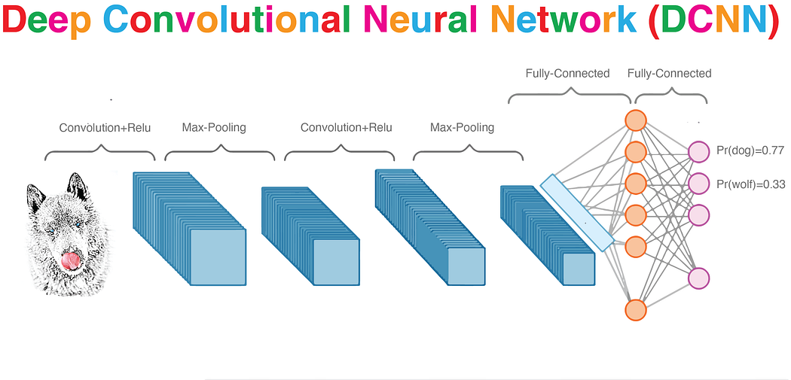
BLOCK DIAGRAM
DCNN
Dataset
Preprocessing
data
Result
Testing
Training

Slide 19
MODULES
Data collection
Preprocessing
Training
Testing

Slide 20
DATA COLLECTION:
The first step is to Collecting data on plant leave diseases is essential for research, disease management, and developing solutions to protect crops and plants. we are collecting the tomato leaves.

Slide 21
PREPROCESSING:
The collected data must be preprocessed to remove any errors or inconsistencies. This may involve removing missing data.

Slide 22
DCNN
CNN compares images piece by piece. The pieces that it looks for are called features which are nothing but a bunch of MxM matrices with numbers(images are nothing but MxM number matrices of pixel values for a computer).
By finding rough feature matches in roughly the same positions in two images, CNNs get a lot better at seeing similarities than whole-image matching schemes.
However, When presented with a new image, the CNN doesn’t know exactly where these features will match so it tries them everywhere, in every possible position(matches feature matrices in steps by shifting the defined steps at a time).
In calculating the match to a feature across the whole image, we make it a filter.
The math we use to do this is called convolution, from which Convolutional Neural Networks take their name.

Slide 23
DCNN ARCHITECTURE

Slide 24
REQUIREMENTS
Hardware:
Intel i3 processor
Minimum 4GB RAM
500 GB SSD Hard drive
Software:
Operating System : Windows 10,11 64 bit system
Python IDE 3.7.6
Software Packages
Tensorflow
Protobuf
Matplotlib
Scikit-learn
Opencv

Slide 25
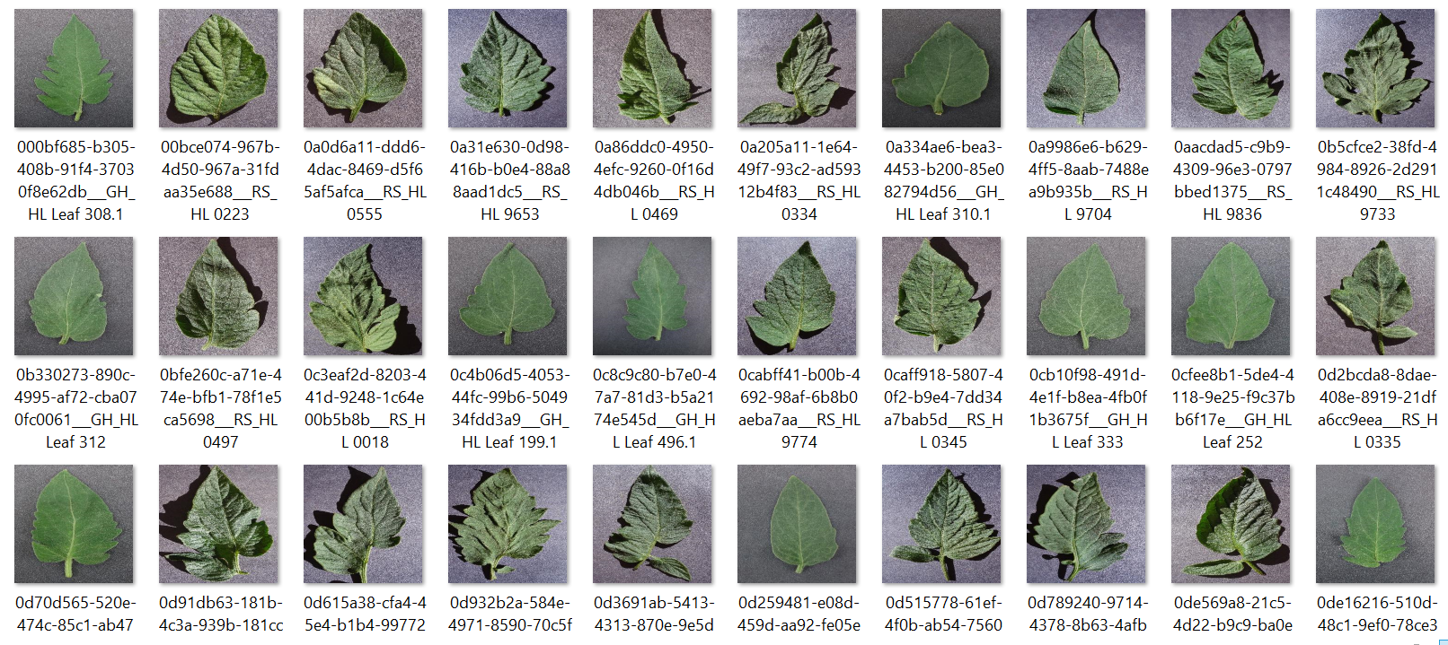
DATASET

Slide 26
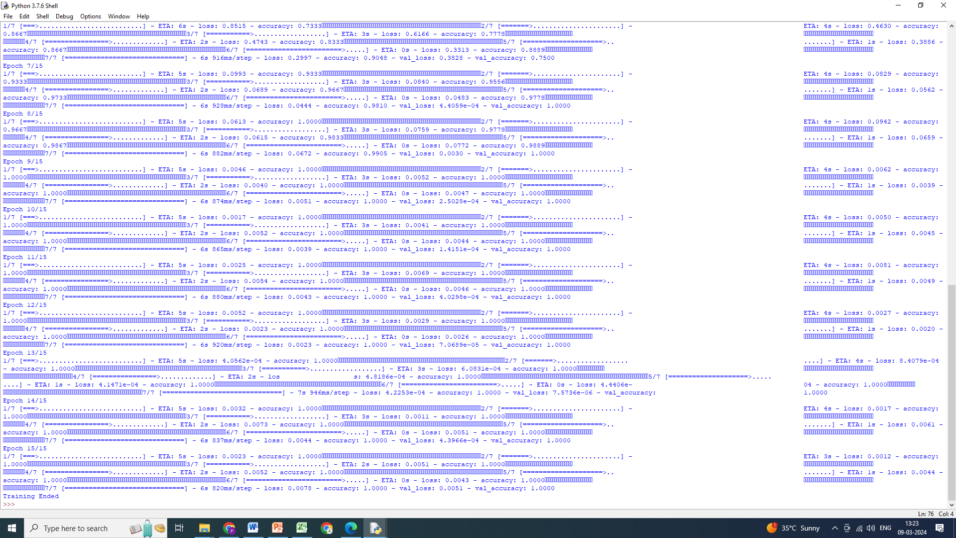
TRAINING

Slide 27
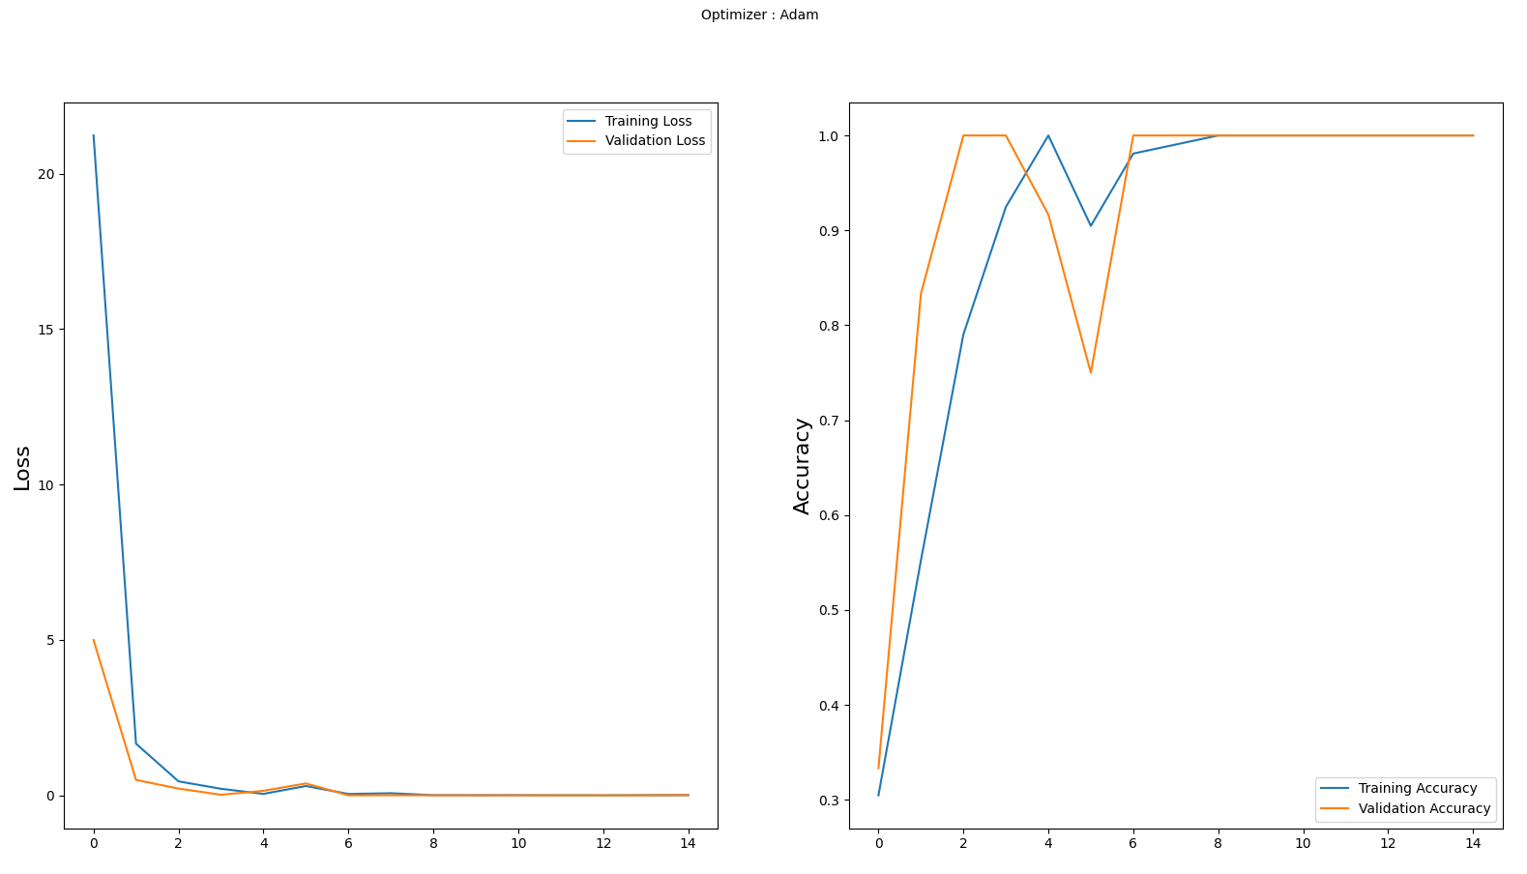
ACCURACY GRAPH LOSS GRAPH

Slide 28
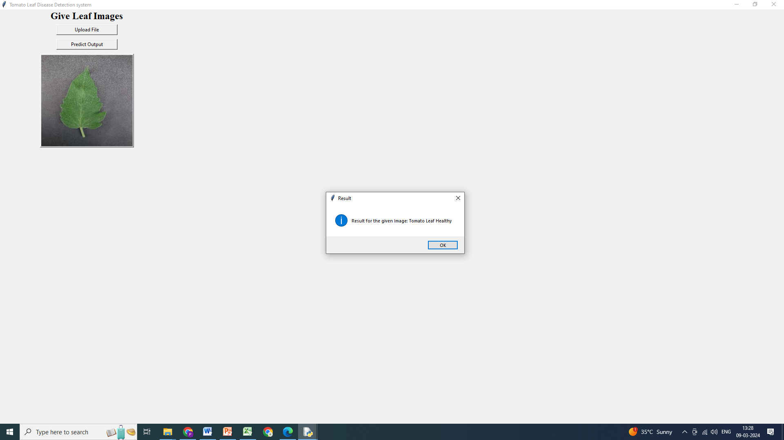
Result-1 Health Detected

Slide 29
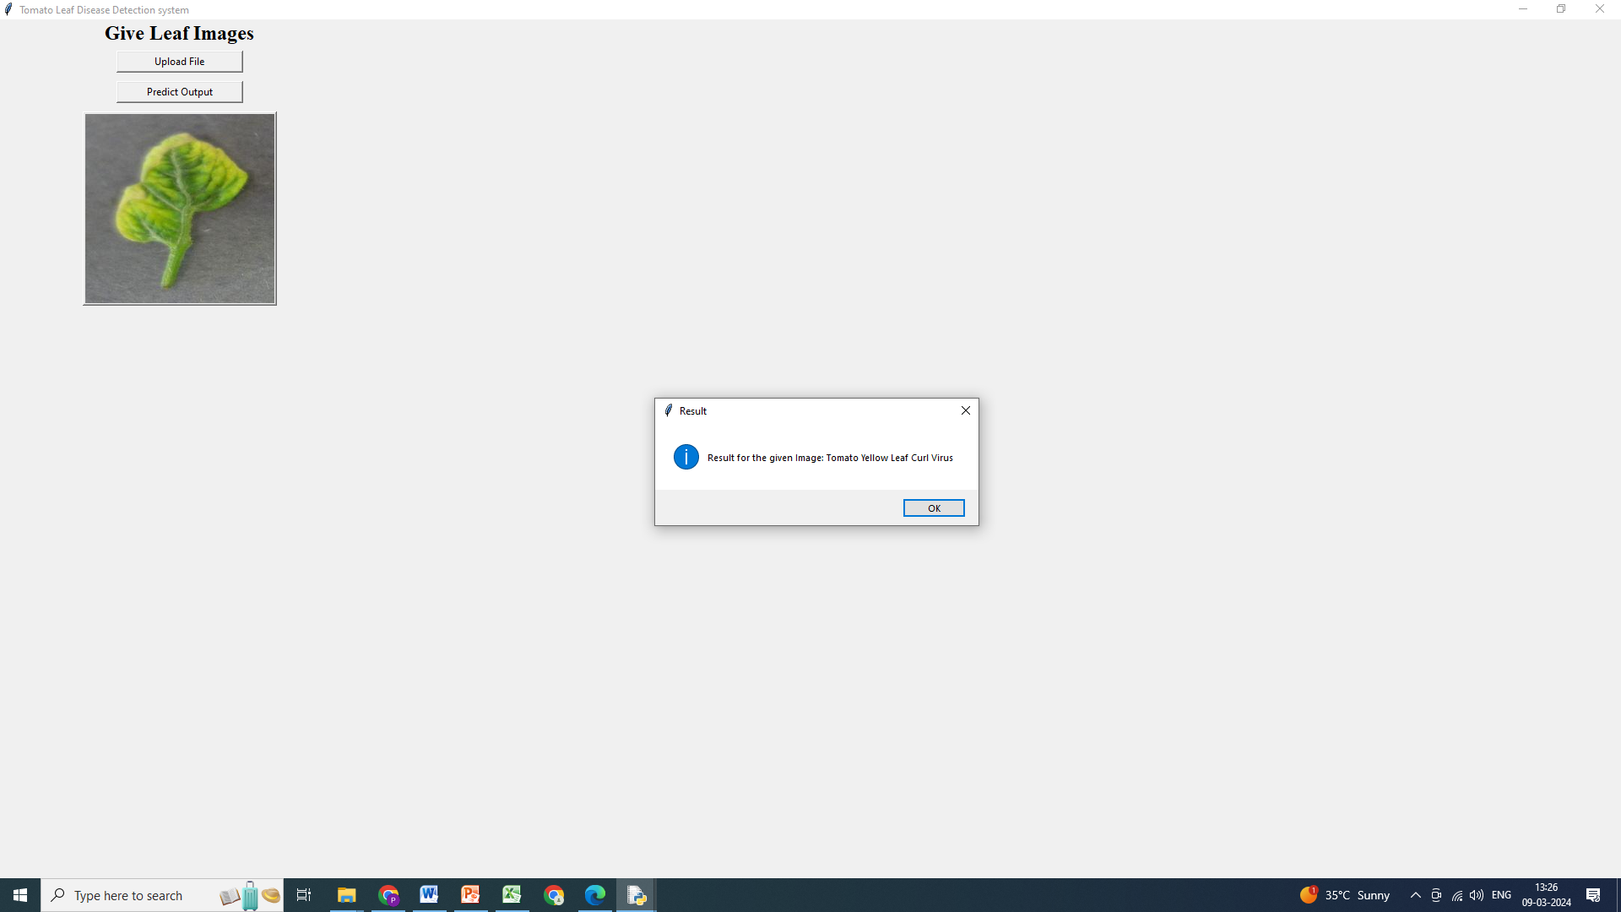
Result-2 Yellow Leaf Curl Detected

Slide 30
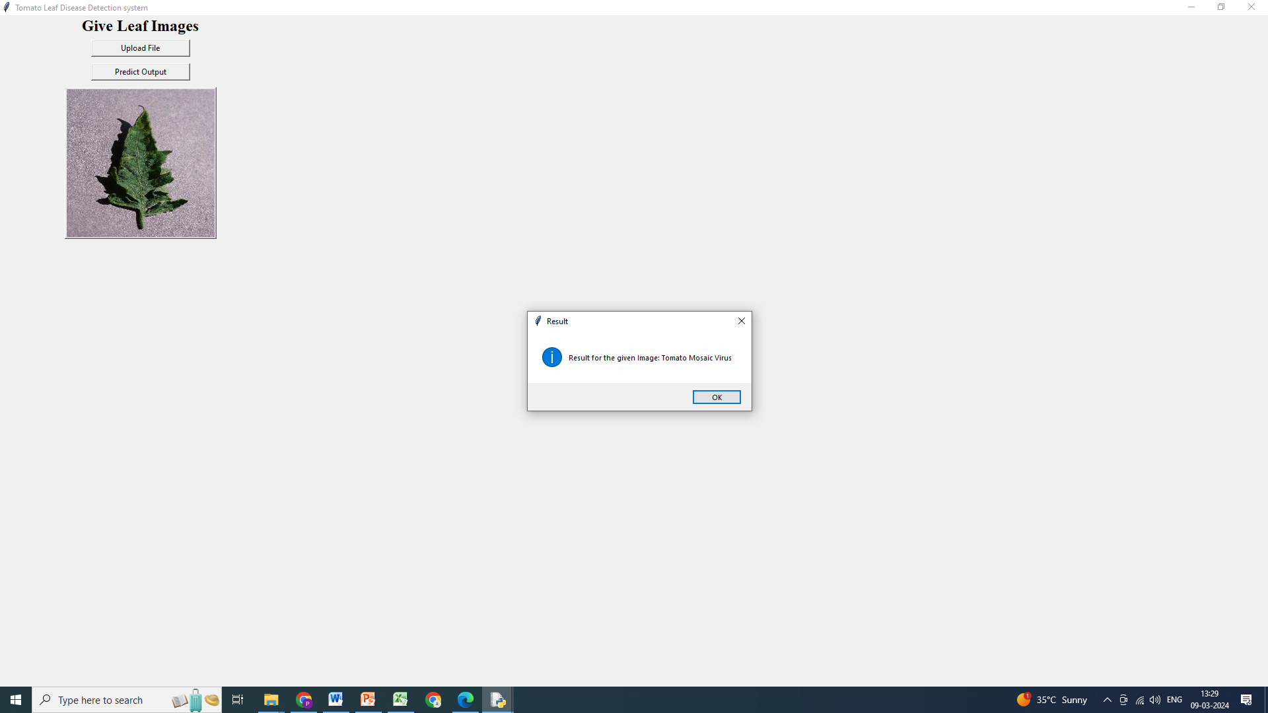
Result-2 Mosaic Virus Detected

Slide 31
CONCLUSION
In this project, we applied the deep convolutional neural network architecture to the task of plant disease classification.
Plant diseases can have a devastating impact on crop yields and food security, making early and accurate detection crucial.
By leveraging deep learning techniques like DCNN, we have made significant strides in automating the detection process.
Our results demonstrate the effectiveness of DCNN in accurately classifying various plant diseases.
‘The model achieved a high level of accuracy in identifying these diseases, surpassing traditional methods and showcasing the potential for AI in agriculture.

Slide 32
REFERENCES
A. K. Pradhan, S. Swain, and J. K. Rout, ‘‘Role of machine learning and cloud-driven platform in IoT-based smart farming,’’2022.
A. Bhargava and A. Bansal, ‘‘Fruits and vegetables quality evaluation using computer vision: A review,’’2021.
A. Ahmad, D. Saraswat, and A. El Gamal, ‘‘A survey on using deep learning techniques for plant disease diagnosis and recommendations for development of appropriate tools,’’ 2023
R. Karthik, M. Hariharan, S. Anand, P. Mathikshara, A. Johnson, and R. Menaka, ‘‘Attention embedded residual CNN for disease detection in tomato leaves,’’ 2020.
O. O. Abayomi-Alli, R. Damasevicius, S. Misra, and R. Maskeliunas, ‘‘Cassava disease recognition from low-quality images using enhanced data augmentation model and deep learning,’’ 2021.

Slide 33
REFERENCES
H.-T. Thai, N.-Y. Tran-Van, and K.-H. Le, ‘‘Artificial cognition for early leaf disease detection using vision transformers,’’ 2021.
A. Khamparia, G. Saini, D. Gupta, A. Khanna, S. Tiwari, and V. H. C. de Albuquerque, ‘‘Seasonal crops disease prediction and classification using deep convolutional encoder network,’’ 2020.
A. J. Rozaqi and A. Sunyoto, ‘‘Identification of disease in potato leaves using convolutional neural network (CNN) algorithm,’’ 2020.
A. Singh and H. Kaur, ‘‘Potato plant leaves disease detection and classification using machine learning methodologies,’’ 2021.
J. Johnson, G. Sharma, S. Srinivasan, S. K. Masakapalli, S. Sharma, J. Sharma, and V. K. Dua, ‘‘Enhanced field-based detection of potato blight in complex backgrounds using deep learning,’’2021.

